Slide 1
Rockbuster Stealth LLC Data Analysis Project of the New Online Video Rental Service
Tableau Visualization
Semiha Ali, January 2024

Slide 2
Introduction
Rockbuster Stealth LLC, a global movie rental enterprise that once boasted a widespread presence with physical stores worldwide, is currently confronted with intense competition from streaming giants like Netflix and Amazon Prime.
To counter this challenge, the management team at Rockbuster Stealth is strategizing to leverage their current movie licenses for the introduction of an online video rental service, aiming to ensure continued competitiveness in the market.

Slide 3
Key Questions & Objectives
Aim of this presentation is to answer key questions and to provide useful insights to the management team for shaping their 2020 company strategy.
Key Questions:
What was the average rental duration for all videos?
Which movies contributed the most/least to revenue gain?
Which countries are Rockbuster customers based in?
Where are customers with a high lifetime value based?
Do sales figures vary between geographic regions?

Slide 4
Data Overview Rockbuster’s data base contain a large amount of insightful data. Below is a data overview of key points from within the film and customer data.
 | Rental Duration | Rental Rate | Replacement Cost
Minimum | 3 Days | $0,99 | $9,99
Average | 5 Days | $2,98 | $19,98
Maximum | 7 Days | $4,99 | $29,99
Number of films: 1000 Language: English Number of customers: 599 Available in 109 countries Total Revenue: $61,312

Slide 5
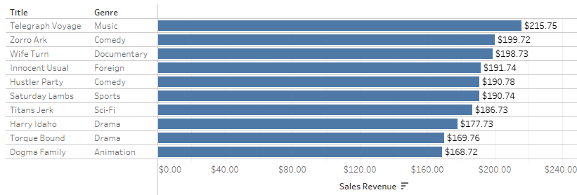
Analysis: Top 10 Most Profitable Movies

Slide 6
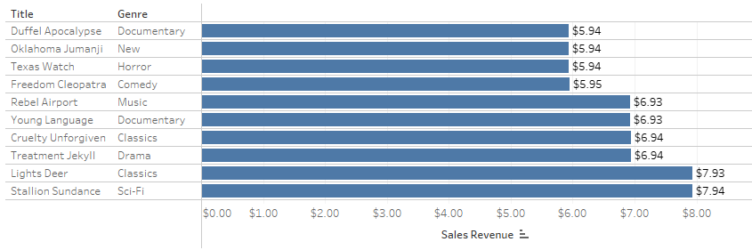
Analysis: Bottom 10 Least Profitable Movies

Slide 7
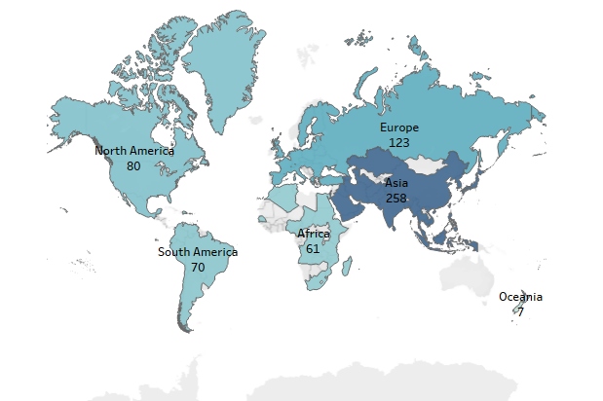
Analysis: Geographic Distribution of Rockbuster Customers
Countries:109
Total Customers:599
Asia:258
Europe:123
North America:80
South America:70
Africa: 61
Oceania: 7

Slide 8
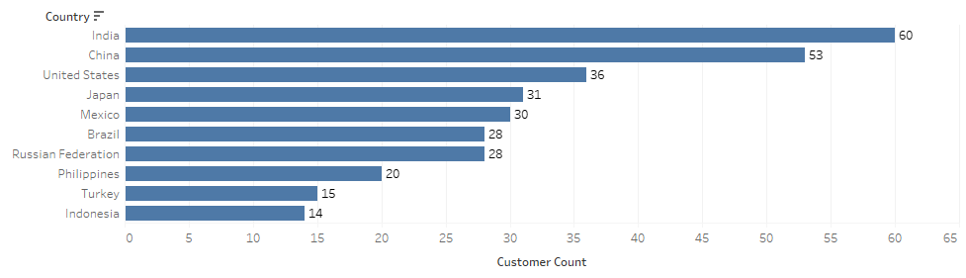
Analysis: Top 10 Countries with Highest Customer Numbers

Slide 9
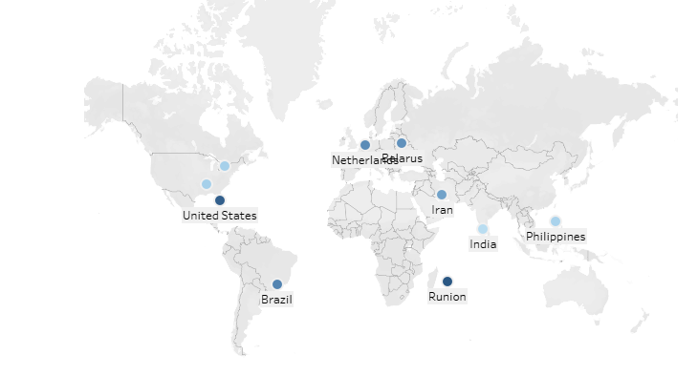
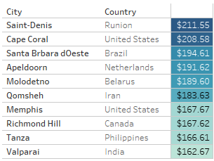
Analysis: Rockbuster’s Most Valued Customers
Rockbuster's most valued customers contribute 3% of the total revenue.

Slide 10
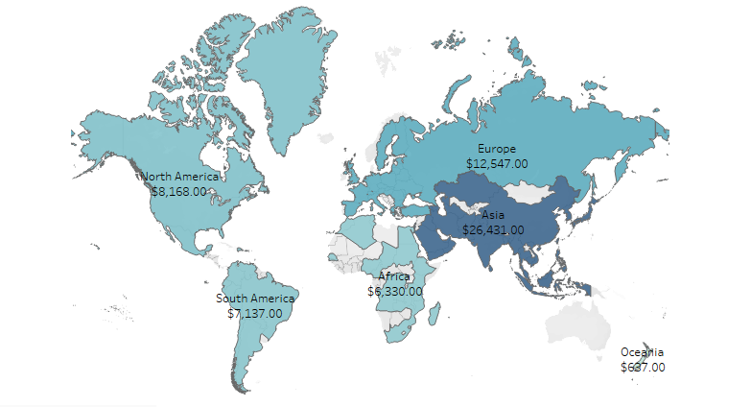
Analysis: Sales Figures Across Geographic Regions

Slide 11
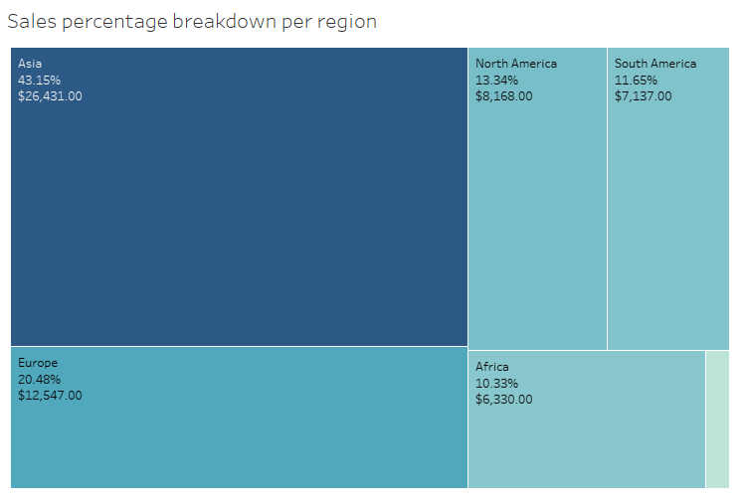
Analysis: Sales Figures Across Geographic Regions

Slide 12
Analysis: Sales Figures Across Geographic Regions
Region | #of Customers | Revenue per region | % of Total Revenue | Average revenue per customer
Asia | 258 | $26,431 | 43.15% | $102.45
Europe | 123 | $12,547 | 20.48% | $102.01
North America | 80 | $8,168 | 13.34% | $102.10
South America | 70 | $7,137 | 11.65% | $101.96
Africa | 61 | $6,330 | 10.33% | $103.77
Oceania | 7 | $637 | 1.04% | $91

Slide 13
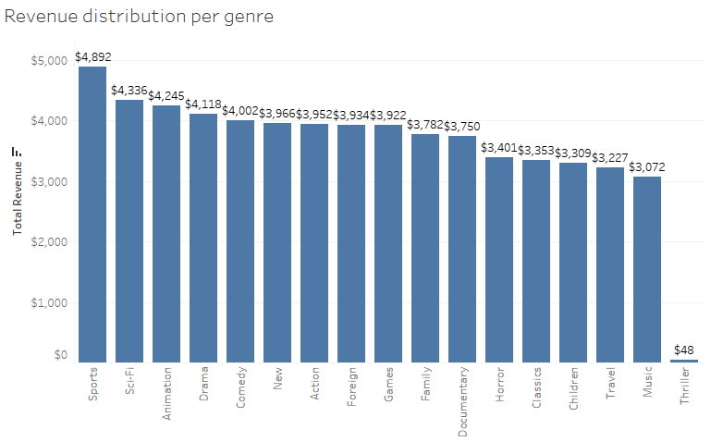
Analysis: Revenue Distribution per Genre

Slide 14
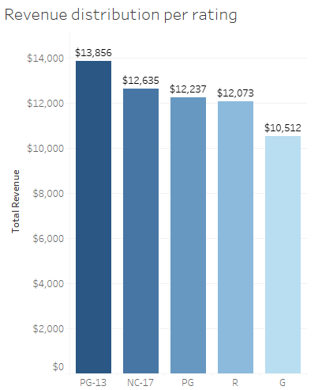
Analysis: Revenue Distribution per Rating

Slide 15
Conclusions
Our diverse customer base spans 109 countries, reflecting Rockbuster's global appeal.
The top 10 countries represent a remarkable 52% of Rockbuster's total customer count.
India and China: Lead the chart with the highest customer counts, reflecting Rockbuster's popularity in these markets. India and China collectively account for nearly 1/5 (20%) of Rockbuster's total customer count.
Certain genres, such as Sports, Sci-Fi, and Animation, have demonstrated both popularity and financial success.
Ratings like PG-13 and NC-17 contribute significantly to overall revenue, emphasizing the importance of catering to varied audience preferences.

Slide 16
Recommendations
Targeted Marketing:
Implement targeted marketing campaigns tailored to high-performing genres and ratings.
Leverage customer data to create personalized content recommendations and promotions.
Niche Exploration:
Explore niche markets, such as the NC-17 category, and consider strategic content investments to capture untapped audiences.
Collaborations and Partnerships:
Foster collaborations with filmmakers and studios to create exclusive content.
Explore strategic partnerships with other entertainment platforms for cross-promotions and extended reach.

Slide 17
Recommendations
Adapt to Trends:
Stay agile and adapt content strategies based on evolving viewer preferences and industry trends.
Invest in advanced analytics to gain deeper insights into customer behaviour and content performance.
Global Expansion:
Continue to expand and strengthen Rockbuster's global presence through targeted regional content and marketing strategies.
Identify growth opportunities in underrepresented regions such as Oceania and Africa to diversify the customer base.

Slide 18
Questions?
Semiha Ali
semiha.sami.ali@gmail.com

